Slide 1
Coding Guidelines
C#

Slide 2
Terminology & Definitions
Use of resharper is must
Code will be committed only after confirming (self) that the coding guideline is followed
Policy to compile every checkin

Slide 3
Terminology & Definitions
The following terminology is referenced throughout presentation
Camel Case
A word with the first letter lowercase, and the first letter of each subsequent word-part capitalized. Example: customerName
Pascal Case
A word with the first letter capitalized, and the first letter of each subsequent word-part capitalized. Example: CustomerName
Access Modifier
C# keywords public, protected, internal, and private declare the allowed code-accessibility of types and their members. Although default access modifiers vary, classes and most other members use the default of private. Notable exceptions are interfaces and enums which both default to public
Hungarian Notation
Hungarian notation is an identifier naming convention in computer programming, in which the name of a variable or function indicates its type or intended use
Examples:
strFirstName - this can just be firstName since it's obvious what it's for, the type isn't that important and should be obvious in this case. If not obvious, the IDE can help you with that.
txtFirstName - this can change to FirstNameTextBox or FirstName_TextBox. It reads better and you know it's a control and not just the text.
ixArray (index to array) - ix is a bit obscure. Try arrayIndex.

Slide 4
Naming Conventions
Identifier | Public | Protected | Internal | Private | Notes
Project File | P | x | x | x | Match Assembly & Namespace.
Source File | P | x | x | x | Match contained class.
Other Files | P | x | x | x | Apply where possible.
Namespace | P | x | x | x | Partial Project/Assembly match.
Class or Struct | P | P | P | P | Add suffix of subclass.
Interface | P | P | P | P | Prefix with a capital I.
Generic Class | P | P | P | P | Use T or K as Type identifier.
Method | P | P | P | P | Use a Verb or Verb-Object pair.
Property | P | P | P | P | Do not prefix with Get or Set.
Field | P | P | P | _c | Only use Private fields. No Hungarian Notation!
Constant | P | P | P | _c
Static Field | P | P | P | _c | Only use Private fields.
Enum | P | P | P | P | Options are also PascalCase.
Delegate | P | P | P | P
Event | P | P | P | P
Inline Variable | x | x | x | c | Avoid single-character and enumerated names.
Parameter | x | x | x | c
“c” = camelCase
“P” = PascalCase
“_” = Prefix with _Underscore
“x” = Not Applicable.

Slide 5
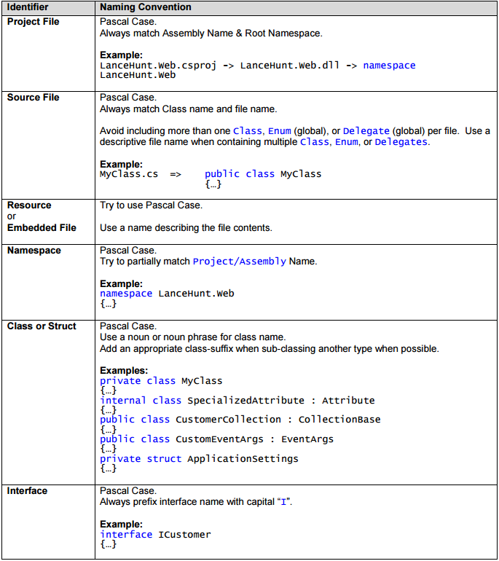
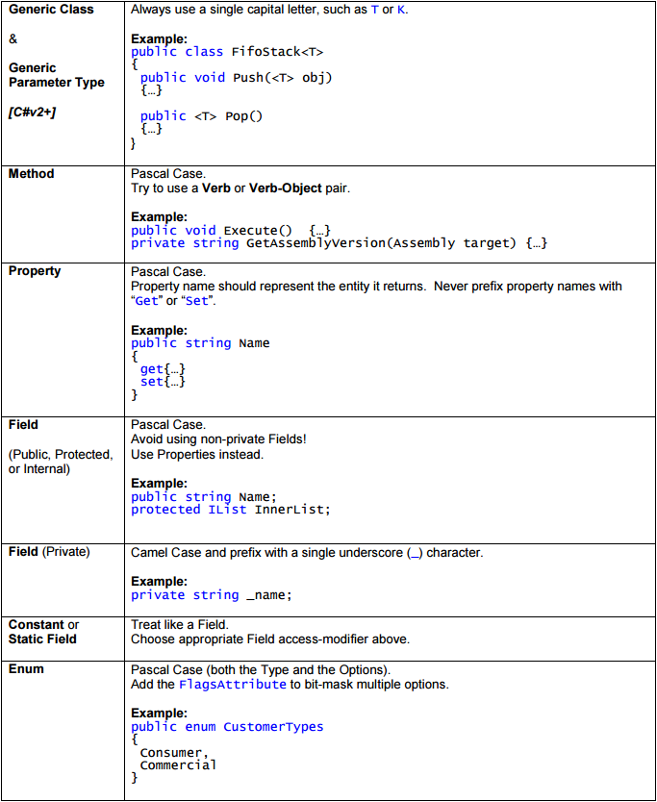
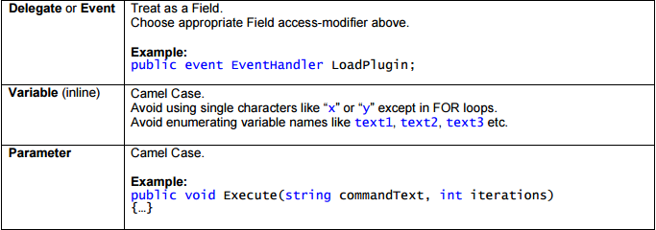
Naming Conventions

Slide 6
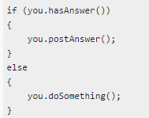



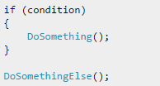
Coding Style - General
Do not omit access modifiers. Explicitly declare all identifiers with the appropriate access modifier instead of allowing the default.
Example:
// Bad!
Void WriteEvent(string message)
{…}
// Good!
private Void WriteEvent(string message)
{…}
Avoid putting multiple classes in a single file.
Always place curly braces ({ and }) on a new line.
Always use curly braces ({ and }) in conditional statements.
// Good!
// Bad!
// Bad!
// Confused!
wonder if the author intended
// Good!

Slide 7

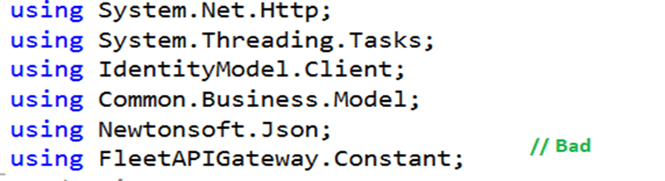
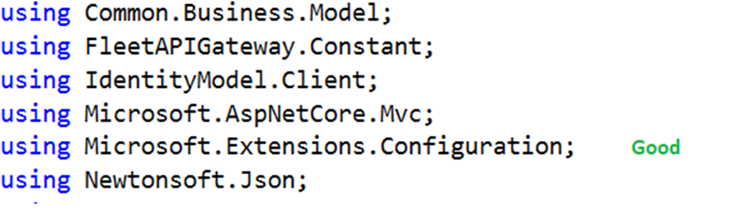
Coding Style - General
Always use a Tab & Indention size of 4.
Declare each variable independently – not in the same statement.
Place namespace “using” statements together at the top of file. Group .NET namespaces above custom namespaces.
4. Group internal class implementation by type in the following order:
Member variables.
Constructors & Finalizers.
Nested Enums, Structs, and Classes.
Properties
Methods
5. Sequence declarations within type groups based upon access modifier and visibility:
Public
Protected
Internal
Private
// Bad!
// Good!
// Bad!

Slide 8
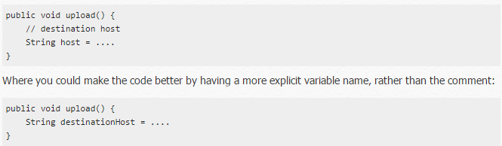
Coding Style - Commenting
All comments should be written in the same language, be grammatically correct, and contain appropriate punctuation.
Use // or /// but never /* … */
Do not “flowerbox” comment blocks.
Example:
// ***************************************
// Comment block
// ***************************************
4. Use inline-comments to explain assumptions, known issues, and algorithm insights.
Do not use inline-comments to explain obvious code. Well written code is self documenting.
6. Only use comments for bad code to say “fix this code” – otherwise remove, or rewrite the code!
7. Include comments using Task-List keyword flags to allow comment-filtering.
Example:
// TODO: Place Database Code Here (Ctrl + W+ T)
// UNDONE: Removed P\Invoke Call due to errors
// HACK: Temporary fix until able to refactor
8. Always apply C# comment-blocks (///) to public, protected, and internal declarations.
9. Only use C# comment-blocks for documenting the API.
10. Always include <summary> comments. Include <param>, <return>, and <exception> comment sections where applicable.
// obvious code

Slide 9
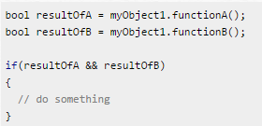


Coding Style – Flow Control
Avoid invoking methods within a conditional expression.
Example:
2. Use the ternary conditional operator only for trivial conditions. Avoid complex or compound ternary operations. Example:
3. Avoid evaluating Boolean conditions against true or false. Example: // Bad! if (isValid == true) {…} // Good! if (isValid) {…}
// Bad!
// Good!
// Good!
// Bad!

Slide 10
Coding Style – Flow Control
Avoid compound conditional expressions – use Boolean variables to split parts into multiple manageable expressions.
// Bad! if (((value > _highScore) && (value != _highScore)) && (value < _maxScore)) {…} // Good! isHighScore = (value >= _highScore); isTiedHigh = (value == _highScore); isValid = (value < _maxValue); if ((isHighScore && ! isTiedHigh) && isValid){…}

Slide 11
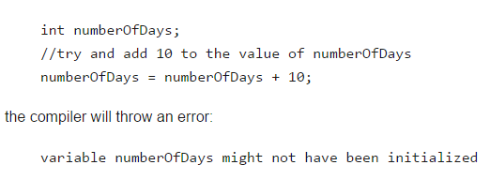

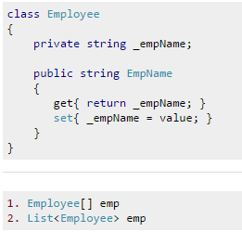

Coding Style - Variables & Types
Try to initialize variables where you declare them.
Always choose the simplest data type wherever required.
// Good!
// Bad!

Slide 12
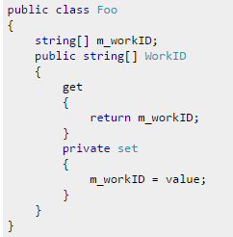
Coding Style - Variables & Types
Try to use int for any non-fractional numeric values that will fit the int datatype - even variables for nonnegative numbers.
Only use long for variables potentially containing values too large for an int.
int - 32 bit (7 digits)
long - 64 bit (15-16 digits)
Try to use double for fractional numbers to ensure decimal precision in calculations.
Only use float for fractional numbers that will not fit double or decimal.
Try to use decimal when fractional numbers must be rounded to a fixed precision for calculations. Typically this will involve money.
Float - 32 bit (7 digits)
Double - 64 bit (15-16 digits)
Decimal - 128 bit (28-29 significant digits)
Only declare constants for simple types.
Prefer String.Format() or StringBuilder over string concatenation.
Always use the built-in C# data type aliases, not the .NET common type system (CTS). Example: short NOT System.Int16 int NOT System.Int32 long NOT System.Int64 string NOT System.String
Only declare member variables as private. Use properties to provide access to them with public, protected, or internal access modifiers.
// Good!

Slide 13
Code review checklist
Common points
Proper namespace
Remove unused references
Proper indenting
Remove unused methods
Regions
Spelling mistakes
Comments – as description at interface level
Use of string builder / todo

Slide 14
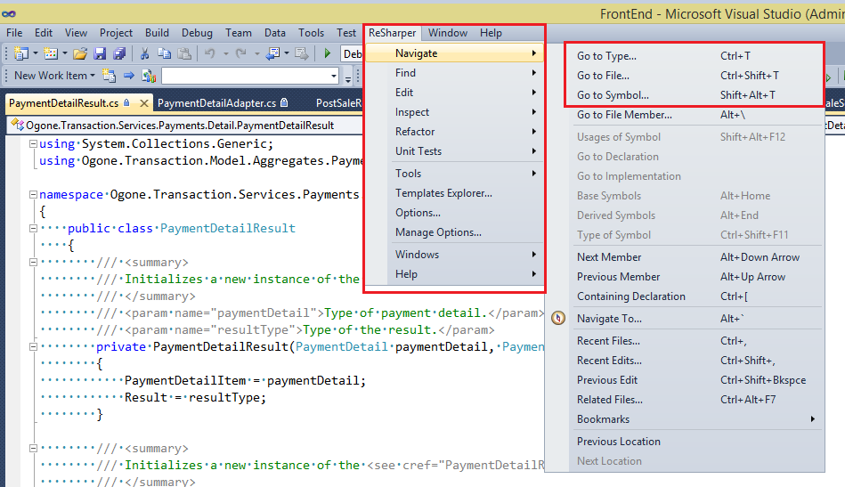
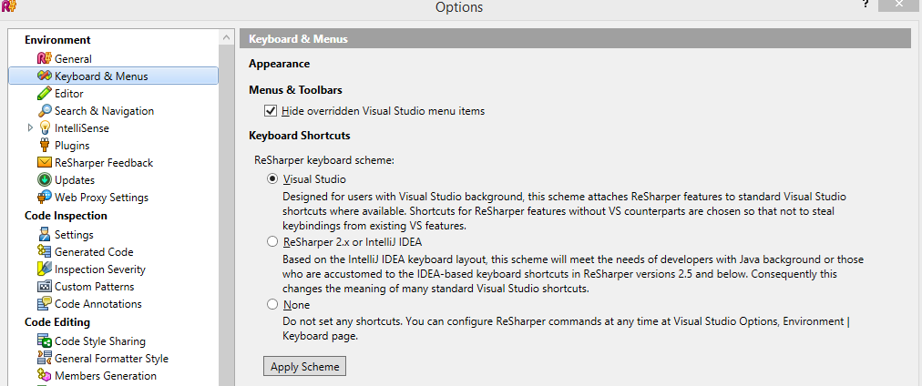
Resharper usage
Mainly used for
Instantly traverse the entire solution
To navigate to any file /symbol

Slide 15
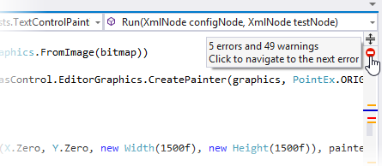
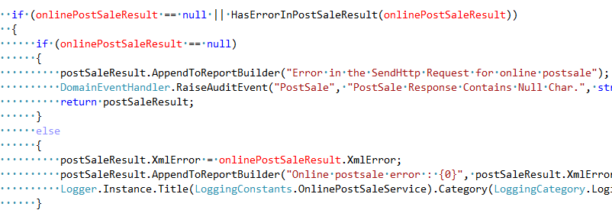
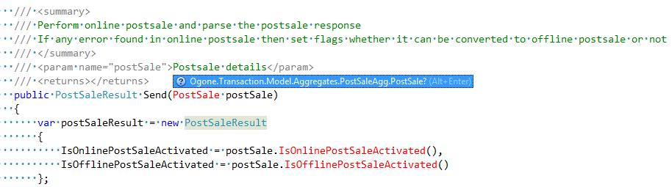
Code Quality Analysis
Detecting Errors and Code Smells
Detects errors
Unreachable code areas
Hints
Quick fixes
Refactoring suggestions
Safely changing base of the files
Renaming / Adjusting name space
Code cleanup

Slide 16
Thank You

